Slide 1
Design Thinking :
Room Allocation for Patient
Group Member:
Yat Chit Law

Slide 2
Design thinking infographics
Problem
Room allocation for Patients in Hospitals
Empathy Map
Define
Ideate
Prototype
Implement
Testing with group 4
Hospital Manager is our target user
Managing limited resources, making difficult ethical decisions, and coping with staff burnout
Monitoring available resources and Matching available resources
Real-time resources sharing platform by using A.I.
Feedback

Slide 3
Empathy Map
Hospital Manager
01
02
03
04
05
PAIN 1
PAIN 2
PAIN 3
PAIN 4
PAIN 5
Insufficient bed and staffs
Witnessing the effect on patients and staff may be emotionally draining for him.
Managing limited resources, making difficult ethical decisions
When the hospital's capacity is surpassed, putting patient care at risk.
Struggles with the problem of distributing limited resources, particularly amid catastrophic shortages like as the COVID-19 epidemic.

Slide 4



Requirement Define
Standardize
Remodeling
standardize patient care to guarantee patient safety at such critical times
Converting conference halls, cafeterias, and administrative facilities might help hospital administration find locations that can accommodate extra beds
Share Resources
Visualization
Donation
Hospital administration requires additional resources to serve more patients.
a way to collaborate with with other healthcare facilities or organizations to share resources or acquire additional space for patient care
examine bed capacity and identify the gap between available rooms and the projected COVID-19 spike to allocate rooms before the surge

Slide 5
IDEATE SOLUTION
Real-time Bed Management
Optimal Resource Allocation
Patient Matching
Staff Allocation
Resource Sharing Platform
Real-time Monitoring of Location Availability

Slide 6
Product
B
E
D
M
A
T

Slide 7




KEY TASK
TASK 1
TASK 2
TASK 3
TASK 4
TASK 5
FILL UP QUESTIONNAIRE
INPUT PREFERED LOCATION
MATCHING RESULT
VALID TIME
or
WAITING TIME
CONFIRMATION

Slide 8
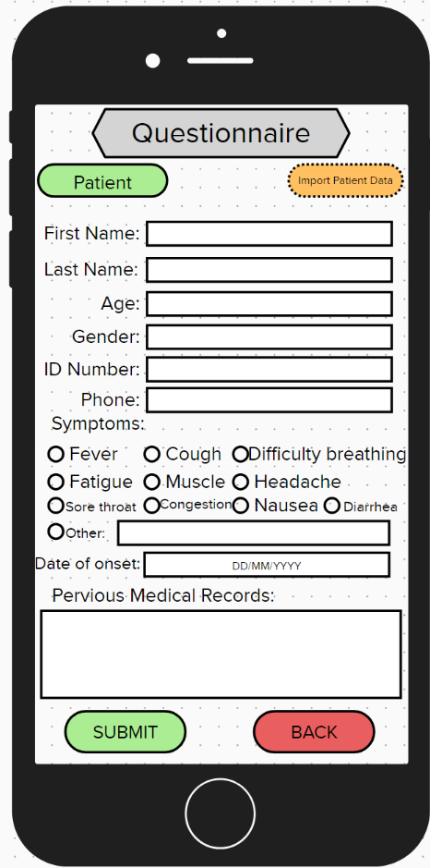

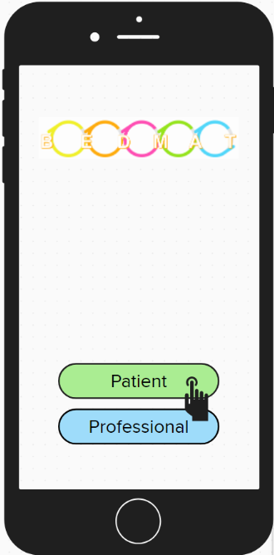

TASK 1: FILL UP QUESTIONNAIRE
SCENARIO
HOSPITAL MANAGER
You want to upload the condition of the patient to replace the questionnaire
PATIENT
You need to provide your condition for evaluating severity
For Medical Staff only
After filling out the questionnaire, submit it and turn to the location page

Slide 9
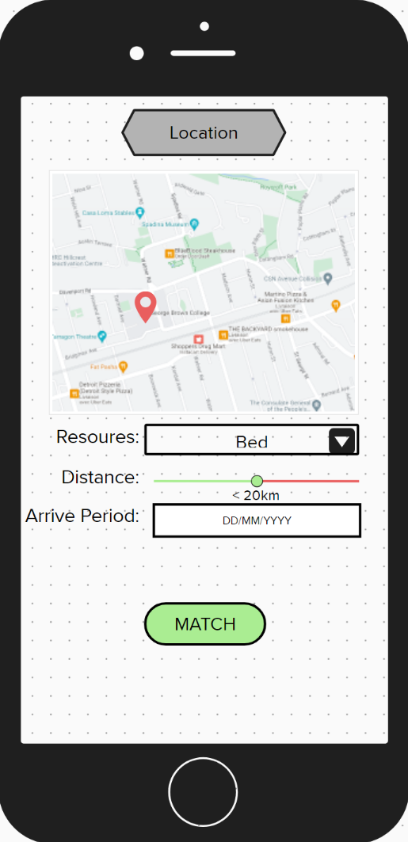

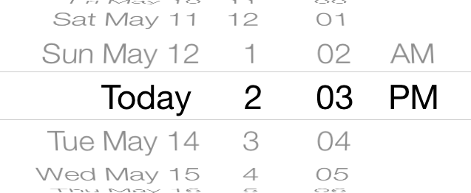
TASK 2: INPUT PREFER LOCATION
SCENARIO
HOSPITAL MANAGER
You want to search the resources needed available near your hospital
PATIENT
You want to search for an available bed to get treatment nearby
Other options for Medical Staff only
Users can select how far they want
Start matching

Slide 10
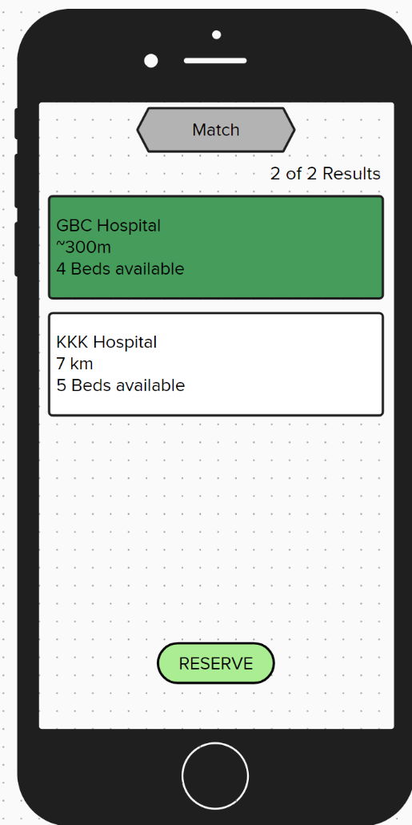
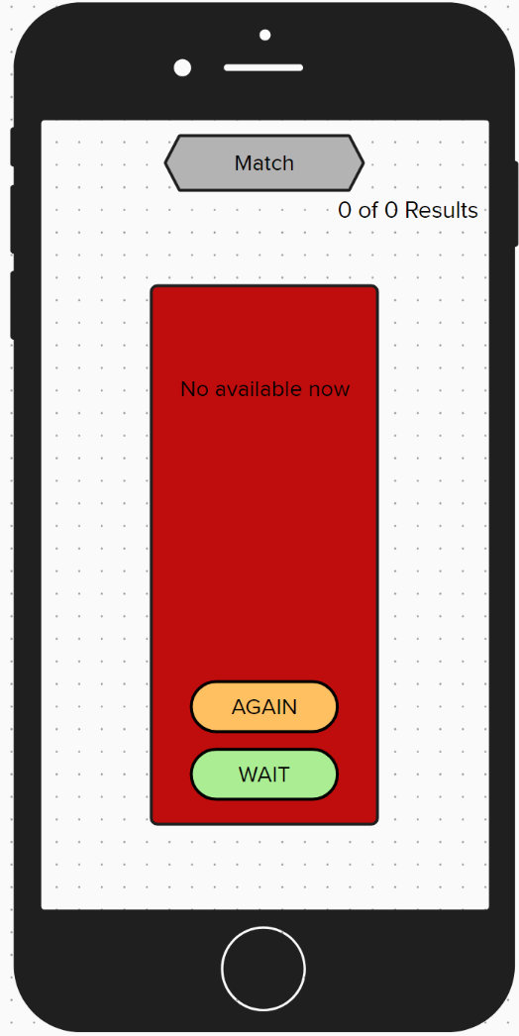

TASK 3: MATCHING RESULT
SCENARIO
HOSPITAL MANAGER
You will get the matching result
PATIENT
You will get the matching result
You can adjust the requirement to match again
Reserve the resources
You can join the waiting list to get any available on-time

Slide 11
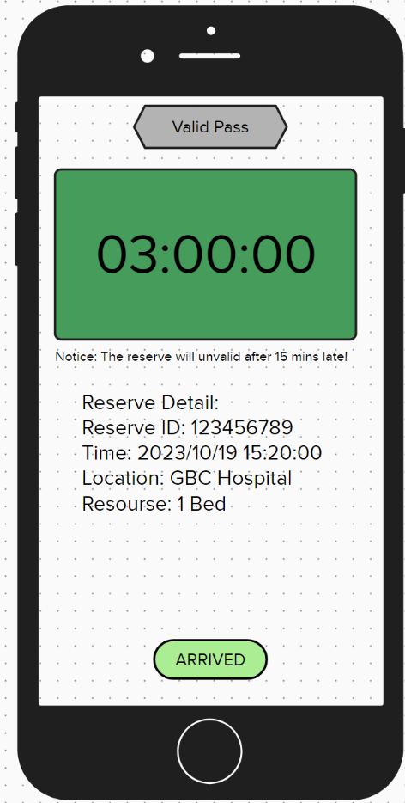
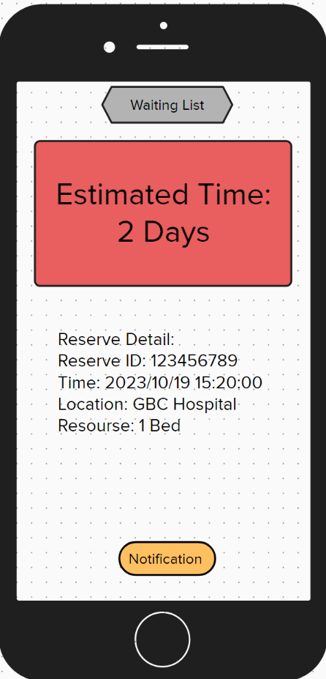
TASK 4: VALID TIME or WAITING TIME
This is a countdown for valid time
SCENARIO
HOSPITAL MANAGER
You will only receive an estimated waiting time when no matching result
PATIENT
You will receive a valid time for confirm the reservation in a hospital or an estimated waiting time
You can set a notification to announce to you if the available resources
Confirm when you arrived

Slide 12
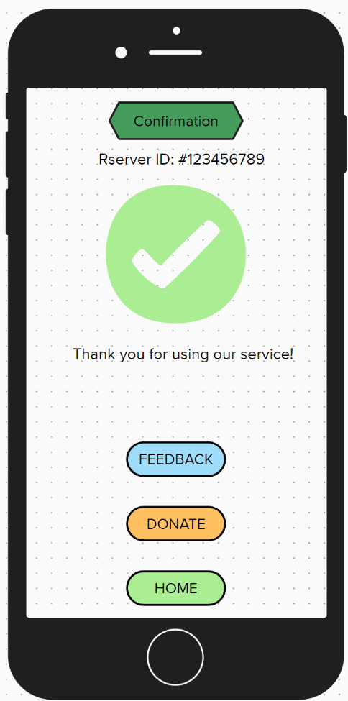


TASK 5: CONFIRMATION
SCENARIO
HOSPITAL MANAGER
You need to confirm the reservation when you arrive and update to the system
PATIENT
You need to confirm the reservation when you arrive and update to the system
The Reserve is done
Users can give any feedback for the using experience
Users can donate to improve our product

Slide 13
Testing Feedback
Q
Q
Q
How do you prioritize patients in extremely severe health after completing out the questionnaire if only one bed is available?
Another patient is worse off than the one who booked a room on the app. Does it hold the patient's bed or the worst?
Already hospitalized patients have no beds. How can it obtain timely treatment?
A
A
The bed should be assigned to the patient in the worst condition first, and then the AI will match another available bed to the patient who has a booking based on this scenario.
A
After assessing the patient depending on their health, the AI checks the waiting list and suggests alternative hospitals with beds if the wait time is greater than 12 hours. Within 12 hours, it advises hospitalization.
Make every effort to ensure that each patient has a bed.

